Slide 1
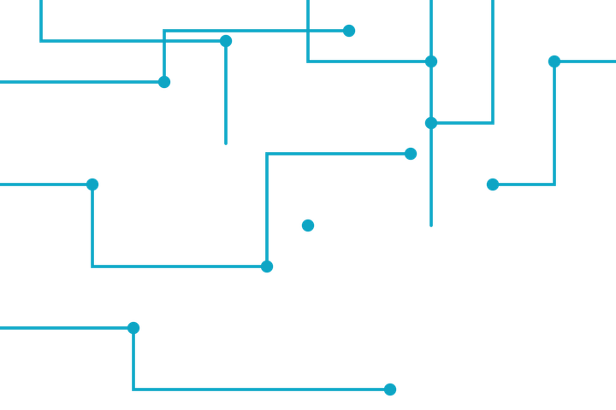




SCIENCE MEETS CIRCUITS
Network Services
DHCP,DNS,NAT,IPv6,Wireless and some commands
Notes:
1

Slide 2



PRESENTER
Rana Haitham
DEPARTMENT
ECE Level 300
POSITION
Network Camp Instructor
CONTACT
ranahythmhsny@gmail.com
Notes:
1

Slide 3





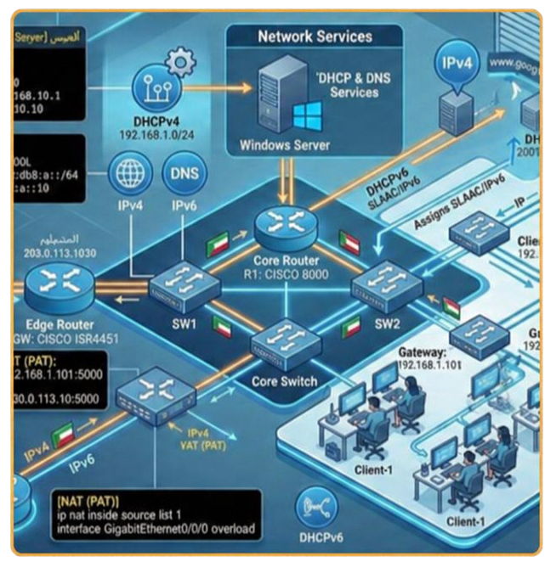









BOOT SEQUENCE
AGENDA
01
DHCP&DNS
02
NATING
03
Wireless Basics
04
Ipv6 concept
AGENDA
Notes:
2

Slide 4






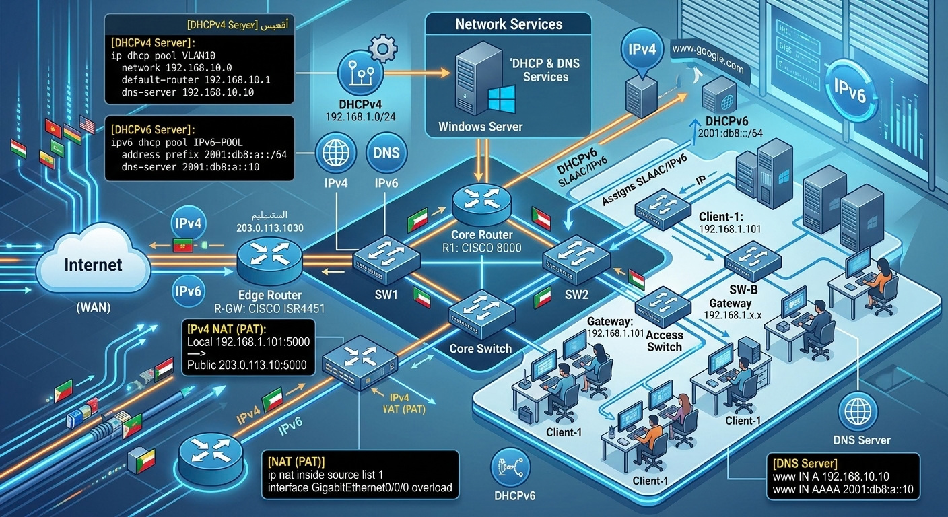




BOOT SEQUENCE
AGENDA
05
OSI MODEL
06
SOME CONFIGURATIONS
Notes:
2

Slide 5


Dynamic Host Configuration Protocol
DHCP automates host addressing, gateway, and DNS configuration.
Two deployment patterns
Router-based DHCP
Local pool leases provide subnet, gateway, DNS, and lease time.
DORA lease exchange
Dedicated DHCP server
  Discover — client broadcasts to find DHCP servers.
  Offer — server proposes an address and options.
  Request — client requests the chosen offer.
  Ack — server confirms the lease.
For routed subnets, ip helper-address on each client-facing router interface relays broadcasts to the central server.
Notes:
2

Slide 6
Domain Name System
DNS maps human-readable names to data such as host addresses.
Resolution path
Common record types
  Client asks its recursive resolver.
  On a cache miss, the resolver follows referrals: root → TLD → authoritative server.
  Authoritative answer returns; resolver caches it and replies to the client.
Record | Purpose
A | Hostname to IPv4 address
AAAA | Hostname to IPv6 address
CNAME | Alias to another hostname
PTR | Address to name (reverse lookup)
Root and TLD servers direct the resolver; the authoritative server provides the zone answer.
Notes:
2

Slide 7

Network Address Translation
NAT conserves public IPv4 addresses by translating private-to-public traffic at a boundary.
Mode | Mapping | Typical use
Static NAT | Fixed one-to-one private public address | Predictable inbound reachability for a host or service
Dynamic NAT | Temporary one-to-one mapping from a public pool | Outbound access when pool addresses are available
PAT / NAT Overload | Many private hosts share one or more public IPs; ports distinguish sessions | Common edge access for many clients
Translation changes packet addressing (and often ports); it is not, by itself, a security policy.
Notes:
4

Slide 8
WLAN Frequencies & Topologies
Choose a band for the environment, then select the right service-set topology.
Frequency tradeoffs
Topology choices
Band | Strength / tradeoff
2.4 GHz | Longest reach; broad compatibility. Crowded, fewer non-overlapping channels, lower capacity.
5 GHz | More channels and throughput; less range and wall penetration than 2.4 GHz.
6 GHz | Wide, cleaner spectrum; shorter reach; Wi-Fi 6E/7 clients; availability varies by region.
IBSS · ad hoc
Stations communicate directly; no access point.
BSS · infrastructure
One AP coordinates a cell of associated clients.
ESS · extended service
Interconnected APs share a network identity for broader coverage and roaming.
Notes:
5

Slide 9

WLAN Security & Authentication
Use modern encryption and choose credentials or centralized identity by scale.
Standards at a glance
WLAN Security Mechanisms
Standard | Practical status
WEP | Broken legacy security; do not use.
WPA / WPA2 | WPA is obsolete. WPA2 with AES-CCMP remains common where supported and securely configured.
WPA3 / SAE | Prefer WPA3-Personal with SAE; improves resistance to offline password guessing.
  MAC Address Filtering Restricts network access based on hardware MAC addresses.
  Disabling SSID Broadcast Hides the network name from public scanning to improve privacy.
  Password Protection Uses WPA2/WPA3 encryption passphrases to secure data in transit.
  IEEE 802.1X Provides enterprise-grade, per-user authentication via a RADIUS server.
Use the strongest mode supported by every client and access point; disable obsolete WEP and WPA.
Notes:
5

Slide 10

IPv4 vs IPv6
Address size, notation, scope mapping, and the shift to a larger Internet.
Dimension | IPv4 | IPv6
Size & notation | 32-bit; dotted decimal (e.g., 192.0.2.1) | 128-bit; hexadecimal groups separated by colons (e.g., 2001:db8::1)
Private scope | Private-use ranges (RFC 1918) | Unique Local Address (ULA, fc00::/7) is the modern private-scope match. Site-local (fec0::/10) is legacy/deprecated.
Public scope | Public IPv4 address | Global Unicast (commonly 2000::/3)
Automatic local fallback | APIPA / link-local (169.254.0.0/16) | Link-local (fe80::/10)
IPv4 drawbacks
IPv6 advantages
  Limited address space contributes to address exhaustion and widespread NAT.
  Broadcast traffic and manual address management can add network overhead.
  Vast address space supports scalable, hierarchical allocation.
  Autoconfiguration, multicast, and Neighbor Discovery support efficient network operation.
  Fixed 40-byte base header with optional extension headers.

Slide 11
IPv6 Notation & Omission Rules
An IPv6 address contains eight 16-bit hexadecimal groups.
Two shortening rules
Worked example
  Drop leading zeros within any group: 0042 becomes 42.
  Compress one consecutive run of zero groups with :: once per address.
2001:0db8:0000:0000:0000:ff00:0042:8329
2001:db8::ff00:42:8329
Each group ranges from 0000 to ffff; internal zeros stay in place.
The double colon replaces three consecutive zero groups. Using it once makes the full eight-group address unambiguous.

Slide 12
OSI Layers & Data Units
Encapsulation maps application data to signals on the medium.
Layer | Name | Typical PDU | Focus
7 | Application | Data | Network services to applications
6 | Presentation | Data | Format, encoding, encryption
5 | Session | Data | Dialog and session control
4 | Transport | Segment (TCP) / Datagram (UDP) | End-to-end delivery and ports
3 | Network | Packet | Logical addressing and routing
2 | Data Link | Frame | Local delivery and MAC addressing
1 | Physical | Bits | Signals over the medium
Mnemonic: Data → Segment / Datagram → Packet → Frame → Bits.

Slide 13
Network Diagnostics & Verification
Verify from local configuration to link, gateway, and end-to-end reachability.
Host checks
Switch / router checks
ping <destination>
Tests IP reachability and round-trip response; ICMP may be filtered.
ipconfig / ifconfig
Inspect local addresses and interface settings. On modern Linux, ip addr is preferred over legacy ifconfig.
show ip interface brief
Check interface IPs and line/protocol state on Cisco IOS.
show vlan
Verify VLAN IDs, names, and access-port membership on a switch.
Compare expected addressing, gateway, DNS, interface state, and VLAN before escalating.
Notes:
3

Slide 14

KNOWLEDGE CHECK
Quiz
Choose the best answer for each question.
1. What is the correct sequence of the DHCP process?
2. What does DNS translate?
A. Discover, Offer, Request, Acknowledge
B. Discover, Request, Offer, Acknowledge
C. Offer, Discover, Acknowledge, Request
D. Request, Discover, Offer, Acknowledge
A. Domain names to IP addresses
B. MAC addresses to VLAN IDs
C. IP addresses to port numbers
D. URLs to encryption keys
3. Many hosts, one public IP + ports
4. Which OSI layer handles IP addressing and routing?
A. Static NAT
B. Dynamic NAT
C. PAT (NAT overload)
D. Destination NAT
A. Data Link (Layer 2)
B. Network (Layer 3)
C. Transport (Layer 4)
D. Application (Layer 7)
Answer key · 1A · 2A · 3C · 4B

Slide 15

ANY QUESTIONS?
system.query( ) awaiting input...
( don't be like Chrome — ask before you fall behind )
Q & A
Notes:
7

Slide 16
THANK YOU
Notes:
8

